Slide 1

Summarizing Data
DMAIC – LSS14
Version: June 2026
Notes:
TIMING: 1.5 MINUTES
SPEAKER SCRIPT
Good morning, everyone, and welcome to Summarizing Data. In this module, we will turn defect information into measures that help us understand process performance. We will connect the calculations to practical Equus work, including customer service, employability support, shared services, and the use of technology and national expertise. The goal is not mathematics for its own sake. The goal is to use the numbers to improve customer experience, strengthen outcomes, and make better use of resources.

Slide 2


Virtual Classroom
Module
90 mins session.
Please mute your microphone if you are not speaking.
Q&A during the session in chat.
Define
Measure
Analyze
Improve
Control
Notes:
TIMING: 2 MINUTES
SPEAKER SCRIPT
We have 90 minutes for this session, so we will combine explanation, worked examples, and activities. Please stay muted when you are not speaking, and use the chat at any point. I will pause regularly so we can work through calculations together. A calculator may be helpful, but the most important part is understanding what each measure tells us and what action it should lead to.

Slide 3
Measure Modules
5 modules you will study in Measure:
Define
Measure
Analyze
Improve
Control
LSS10 Data
LSS11 Data Measurement & Operational Definitions
LSS12 Data Verification
LSS13 Basic Statistics
LSS14 Summarizing Data
Notes:
TIMING: 1.5 MINUTES
SPEAKER SCRIPT
This is the final module in the Measure stage. The earlier modules established how to define, verify, and understand data. Today we bring those ideas together by summarizing process quality through defects, yield, defects per unit, opportunities, DPMO, process sigma, and rolled throughput yield. Each measure gives us a different view, so we will focus on when each one is useful.

Slide 4

Module Learning Outcomes
Summarizing Data – LSS14
By the end of this module, you will: Understand the meaning of defects and yield. Understand the meaning of process baseline and sigma. Be able to calculate defects and opportunities. Understand and be able to apply 'Final Yield' and 'Rolled Throughput Yield'.
Notes:
TIMING: 2 MINUTES
SPEAKER SCRIPT
By the end of the module, you should be able to explain defects and yield, describe a process baseline and sigma, calculate defects and opportunities, and apply Final Yield and Rolled Throughput Yield. As we work, keep one current process in mind. It could be participant intake, referral handling, appointment scheduling, employer engagement, or a shared-service request. That will make the calculations easier to connect to real decisions.

Slide 5
01
Definition of Process Defects and Yields
Summarizing Data
Notes:
TIMING: 0.5 MINUTES
SPEAKER SCRIPT
We will begin with process defects and yields. This section answers two basic questions: what counts as a defect, and how often does the process deliver the expected result first time?

Slide 6

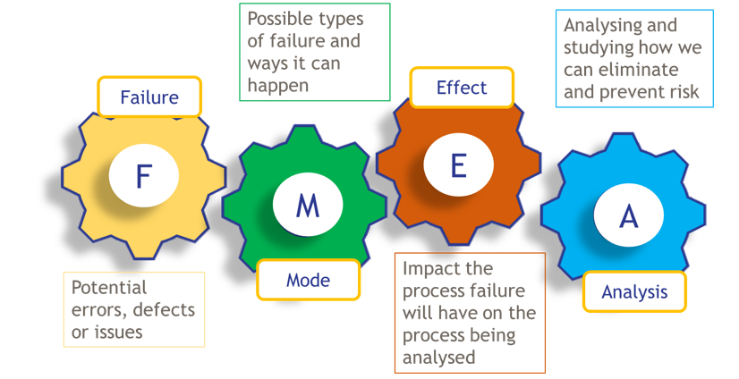
Definition - Defects
Effect
Failure
Impact the failure will have on the process being analyzed.
Defects are defined as:
Potential errors, defects or issues.
Outputs that do not meet expected results.
Customer requirements not achieved.
Variation or human error.
Waste or rework.
We measure defect risk using Failure Mode and Effect Analysis (FMEA) which we will explore in greater detail at various points in DMAIC.
F
M
E
A
Mode
Analysis
Possible types of failure and ways it can happen.
Analyzing and studying how we can eliminate and prevent risk.
Notes:
TIMING: 2.5 MINUTES
SPEAKER SCRIPT
Let's start with the word defect. A defect is any output that does not meet the expected result or the customer's requirement. It might be an error, missing information, a delay, rework, or a service that has to be corrected. In an Equus project, a defect could be an incomplete participant assessment, an employer referral submitted late, or incorrect information that forces a customer to contact us again. FMEA gives us a structured way to think ahead. We identify what could fail, how it could fail, the effect on the customer or process, and what analysis is needed to reduce the risk. The key point is that defects represent missed expectations, and defining them clearly is the first step toward preventing them.

Slide 7
Example Defects
Missing Data
Customer record has no contact number.
Appointment notes not completed.
Mandatory fields in a form left blank.
Incorrect Input
Wrong customer details entered (e.g. name/date of birth).
Incorrect payment type selected.
Data entered in wrong format (e.g. date or Zip code).
Process Delays
Appointment not scheduled within target timeframe.
Approval not completed on time.
Request sits in queue with no action.
Quality Errors
Document contains spelling mistakes.
Incorrect information provided to customer.
Output does not meet agreed standard.
Incomplete
Task started but not finished.
Required documentation not uploaded.
Process skipped a required step.
Notes:
TIMING: 2 MINUTES
SPEAKER SCRIPT
Defects can appear in several forms. Missing data means required information was not captured. Incorrect input means information exists but is wrong or in the wrong format. A delay is also a defect when the customer requirement includes timeliness. Quality errors occur when work does not meet the agreed standard, and incomplete work means a required step was not finished. In workforce services, these categories might include a missing phone number, an incorrect eligibility entry, a delayed appointment, inaccurate guidance, or documentation that was never uploaded. The clearer the definition, the more consistently different teams can identify and measure the issue.

Slide 8
Definition – Final Yield
Final Yield is used to measure the performance of the process.
Definition: % of activities or outcomes completed correctly first time.
Formula:
Number of activities completed correctly
Total number of activities
Final Yield
Key Takeaway: If defects tell us what’s going wrong, final yield tells us how often we’re getting it right first time.
Notes:
TIMING: 2 MINUTES
SPEAKER SCRIPT
Final Yield tells us how often work is completed correctly the first time. We divide the number of activities completed correctly by the total number processed. If 85 out of 100 items are correct first time, the Final Yield is 85 percent. For Equus, this might be the percentage of participant records completed without correction, appointments scheduled correctly first time, or employer referrals submitted with all required information. A high yield means less rework and a more reliable customer experience.

Slide 9

Example
Example:
A bakery produces 100 cakes in a day. Out of these, 85 units are good (no defects the first time). The other 15 were missing some icing or the cherry on the top.
Let’s apply a formula to work out how well the process is working to create cakes right first time.
Step 1 – Apply the formula: Final Yield = Good Cakes / Total cakes
Step 2 – Calculate: Yield = 85 / 100 = 0.85
Step 3 – Convert to percentage: Final Yield = 85%
Final Answer: The Final Yield is 85%, meaning 85% of were produced correctly the first time without rework.
Notes:
TIMING: 2 MINUTES
SPEAKER SCRIPT
Let's apply the formula. The bakery completed 85 of 100 cakes correctly first time. Eighty-five divided by 100 equals 0.85, or 85 percent. The same calculation works in a service process. If 85 of 100 assessments meet the definition without rework, the Final Yield is also 85 percent. The important step is making sure 'correct first time' has been operationally defined before we calculate the result.

Slide 10
Final Yield Limitations
Final yield tells us whether a unit is defective, but it does not show how many defects it contains. While we know some cakes did not meet the required standard, final yield alone cannot tell us the total number of defects.
Example:
Cake A → 1 defect (no icing)
Cake B → 4 defects (Too small, no icing, no sprinkles, no cherry)
In terms of final yield, both cakes are counted the same because both are defective. However, Cake B has more defects and is therefore a poorer-quality product. This is why Defects Per Unit (DPU) is an important measure.
Cake A
Cake B
Key Takeaway: Final yield is useful for a quick view, but to really understand and improve performance, we need to go deeper.
Notes:
TIMING: 2 MINUTES
SPEAKER SCRIPT
Final Yield gives us a useful headline, but it has a limitation. It treats every defective unit the same. One cake with one issue and another cake with four issues are both counted as not right first time. The same can happen in a participant record. One record may have one missing field, while another has missing documentation, an incorrect service code, and an overdue follow-up. Final Yield identifies both as defective but does not show the difference in defect volume. That is why we also use Defects Per Unit.

Slide 11
Final Yield to DPU Flow Example
Unit examples (item to be created or processed):
Cases created
HR requests
Payroll transactions
Leave requests
Benefits inquiries
Employee onboarding/offboarding actions
Units completed
Final
Yield
Defect Free
YES
Defect examples (things that have gone wrong):
Incorrect case update
Payroll processing error
Missing documentation
Wrong benefit enrollment
Completion timescale failure
Case reassignment
Employee/Customer call back required
NO
Final yield examples ( % Items completed first time)
Cases/requests completed correctly the first time
No rework required
No escalation required
Targets met
Final Yield = Right first time
Total number of items
How many defects?
Defects per unit (number of defects of total units)
DPU= Total defects
Total Units completed
DPU
Notes:
TIMING: 2 MINUTES
SPEAKER SCRIPT
This flow shows the relationship. First, count the units completed. If a unit is defect-free, it contributes to Final Yield. If it is not defect-free, count how many individual defects it contains. That count supports DPU. In simple terms, Final Yield asks, 'Did we get it right first time?' DPU asks, 'How many issues were present?' Using both gives a fuller picture of customer quality and the amount of rework hidden inside the process.

Slide 12
Defects Per Unit (DPU)
Rather than simply classifying units as good or bad, DPU counts every defect.
DPU answers the question: “How many defects does each unit contain?”
Final Yield measures how many units are defect-free, while DPU measures the number of defects within those units.
Metric | What it Measures | Focus
Final Yield | % of defect-free units | Outcome (Good vs Bad)
DPU | Average defects per unit | Detail (How many defects)
Yield measures how often we get it right. DPU measures how many defects are present when we get it wrong.
Important: A single unit can have multiple defects.
Notes:
TIMING: 2 MINUTES
SPEAKER SCRIPT
DPU moves us beyond classifying a unit as simply good or bad. It counts every individual defect and expresses the average number of defects per unit. One participant file can contain multiple defects, just as one service request can require several corrections. Yield tells us how often we succeed first time. DPU tells us the scale of the problem when we do not.

Slide 13
DPU Formula
Below is the formula used for calculating the DPU for a cake making process. Figures are example only.
Total Number of Defects
Total Number of Units
DPU (defects per unit)
75
1000
0.075
Once we have our DPU, we can then use this Information to determine whether the process is performing or whether improvement is needed.
Notes:
TIMING: 2 MINUTES
SPEAKER SCRIPT
The DPU formula is total defects divided by total units. In this example, 75 defects divided by 1,000 units equals 0.075 defects per unit. That does not mean every unit contains part of a defect. It is an average across the process. Once we know the DPU, we can monitor whether defect burden is increasing or decreasing and identify where deeper analysis is needed.

Slide 14
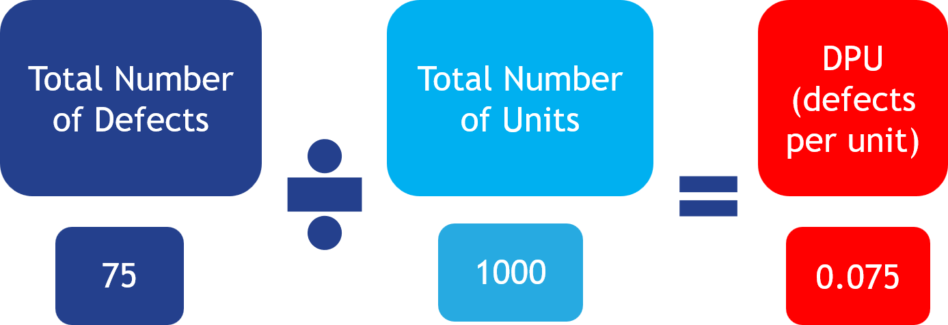
What does this tell us?
DPU is set internally so it varies according to each quality tolerance.
Using a scale is often easier to understand than using DPU numbers.
Having this scale allows us to identify when action needs to be taken.
DPU | Rating | Interpretation
<0.02 | Excellent | Highly capable process
0.02-0.05 | Good | Minor rework
0.05-0.10 | Within Tolerance | Some recurring defects
0.10-0.25 | Needs Improvement | Noticeable rework burden
0.25-0.50 | Poor | Significant quality issues
>0.50 | Critical | Systemic process problems
It is important to note that we can also set our own acceptable scale for defects per unit.
Notes:
TIMING: 2 MINUTES
SPEAKER SCRIPT
A DPU value needs context. The acceptable level depends on the process, customer requirement, risk, and quality tolerance. This example scale translates the number into categories that are easier to discuss. The example DPU of 0.075 falls within the recurring-defect range. That does not automatically mean the process is acceptable for every service. A low-risk administrative correction and an error affecting eligibility or customer safety should not be treated the same. Use the scale as a decision aid, not as a substitute for judgment.

Slide 15

0: highly capable
0.02 – 0.05: Minor rework
0.10 – 0.25: Rework burden
0.05 – 0.10: Recurring
0.25 – 0.50: Significant issues
>50: Systemic Issues
What should we do about it?
DPU = 0.0.75 → Acceptable (Recurring)
What this means:
Defects are recurring and are not isolated incidents.
Action focus:
Identifying where defects recurring in the process before it becomes a bigger issue.
Fixing root causes at high-impact steps.
Reducing complexity and variation.
Preventing defects before they happen (not just fixing after).
Key Takeaway: At this level, the goal is not to fix individual defects. It is to fix the process.
Notes:
TIMING: 2 MINUTES
SPEAKER SCRIPT
At 0.075 defects per unit, the issue is recurring rather than isolated. The response should move beyond fixing individual cases. We need to identify where defects enter the process, investigate root causes, reduce unnecessary complexity, and prevent recurrence. For Equus, that might mean improving a standard template, clarifying an operational definition, adding a system validation, or using national expertise to address a pattern found across several local projects. The goal is to improve the process while preserving the flexibility needed for local delivery.

Slide 16
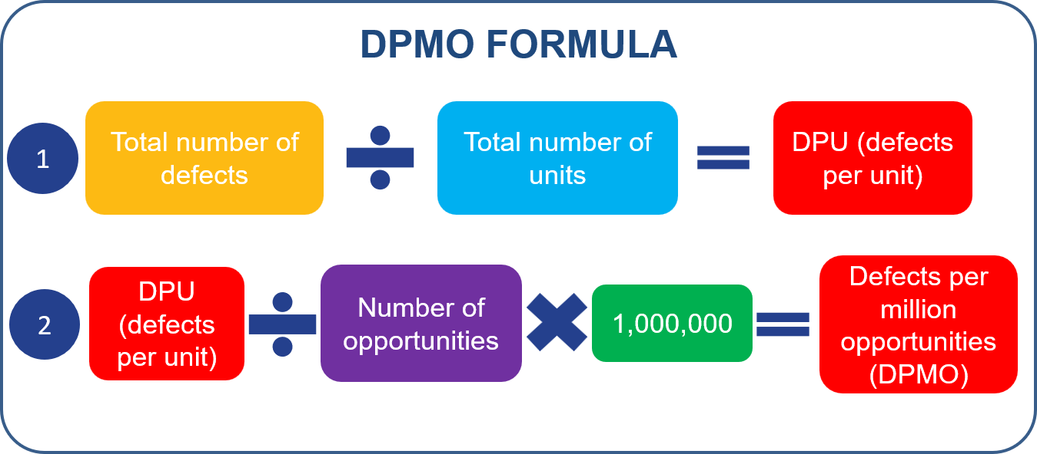
Calculating DPMO
Below are some other key terms you will need to know:
DPU (Defects per Unit): Measures defects per unit (e.g. appointment, service, product etc.).
Number of Opportunities: The number of chances for a defect to occur within ONE unit.
Defects per million opportunities (DPMO):
Uses DPU and opportunities to calculate (predict) defects per million units.
DPMO doesn't mean you need a million cases, referrals, applications, or employees. It's simply a standardized way of predicting defect rates so different processes can be compared.
Notes:
TIMING: 2 MINUTES
SPEAKER SCRIPT
Before calculating DPMO, we need three terms. DPU is defects per unit. Opportunities are the number of defined chances for a defect within one unit. DPMO standardizes the defect rate per million opportunities. A million is only the standard scale. We do not need a million actual cases. The full calculation is DPU divided by opportunities per unit, multiplied by one million. This lets us compare processes with different levels of complexity.

Slide 17
Example: Opportunity Management
Opportunities are defined as the number of chances within a process for a defect to occur. The more components we have in our processes, the more opportunities there are for defects to occur.
Occupational Health Example
An Occupational Health referral has multiple opportunities for defects, including:
Referral information incomplete
Appointment scheduled incorrectly
Medical records incomplete
Return-to-work advice not communicated
By simplifying the referral process and using standard templates, the team can reduce process steps and handoffs.
Complex
Simplified
Referral
Referral
Example Improvements:
Referral review incorporated into booking.
Unnecessary approval removed.
Review
Booking
Approval
Assessment
Assessment
Report
Documentation
Communication
Communication
Key Takeaway: Reducing opportunities for defects is often achieved by removing unnecessary steps, approvals, and handoffs while retaining the activities that add value for the customer.
Notes:
TIMING: 2 MINUTES
SPEAKER SCRIPT
An opportunity is a defined point where a defect could occur. In this referral example, incomplete information, incorrect booking, incomplete records, and missing communication are separate opportunities. Simplifying the process can reduce risk by removing unnecessary approvals, handoffs, and duplicated steps. In Equus work, enabling technology can also reduce opportunities through required fields, workflow routing, and standard templates. The objective is not to remove steps that add customer value. It is to remove avoidable complexity that creates failure points.

Slide 18
How to Determine Opportunities
When working out the number of opportunities for defects, you need to ensure consistency.
1. | Identify defects: Prepare an initial list of possible defect types.
2. | Categorize defects: Actual defects – physical faults (e.g., cracks, damage). Customer-critical defects – impact customer satisfaction. Process-specific defects – related to how the process operates.
3. | Focus on routine defects: Exclude one-off or non-routine issues.
4. | Group similar defects: Combine related defects together.
5. | Apply a consistent definition: Opportunities should reflect where defects can occur, not every possible failure scenario.
6. | Validate against standards: Cross-check opportunities with specifications and tolerances.
8. | Maintain consistency: Avoid changing definitions once measurement begins.
Notes:
TIMING: 2.5 MINUTES
SPEAKER SCRIPT
Opportunity definitions must remain consistent. Begin with the routine defect types that matter to the customer or process. Group similar defects, connect them to the points where they can occur, and validate the list against standards and tolerances. Avoid counting every imaginable failure scenario. We want a practical set of repeatable opportunities. Once measurement begins, do not change the definition without documenting the change, because that would make results difficult to compare over time or across projects.

Slide 19
Opportunities and DPMO Summary
Identify defect opportunities per item
Scenario:
A bakery produces 100 cakes.
Each cake has 3 defect opportunities:
Sponge baked correctly
Icing applied correctly
Decoration added (e.g. cherry)
Calculate the total opportunities (what could go wrong)
100 cakes x 3 opportunities
Calculate DPU (what did go wrong)
3 defects/100 cakes = 0.03 defects per cake
Apply DPMO
DPMO = (DPU ÷ Opportunities) × 1,000,000
= (0.03 ÷ 3) × 1,000,000
= 10,000 cake defects per million opportunities
Notes:
TIMING: 2.5 MINUTES
SPEAKER SCRIPT
This example brings the calculation together. One hundred cakes, with three opportunities per cake, create 300 total opportunities. Three defects across 100 cakes give a DPU of 0.03. Divide 0.03 by three opportunities and multiply by one million. The result is 10,000 DPMO. Opportunities represent what could go wrong. DPU represents what did go wrong per unit. DPMO places that performance on a common scale.

Slide 20
Real Work Example: Occupational Health
Scenario: Occupational Health Referrals
A team manages 100 occupational health referrals.
Each referral has defect opportunities:
Employee assessment booked correctly
Medical information recorded correctly
Return-to-work recommendation communicated correctly
Assume: 3 defects found across the 100 referrals.
Examples of Defects:
Incorrect appointment scheduling
Missing medical documentation
Return-to-work guidance not communicated
Identify defect opportunities per item
Calculate the total opportunities (what could go wrong)
3 defects x 100 referrals = 300 opportunities
Calculate DPU
(what did go wrong)
3defects/100 referrals = 0.03 defects per item
Apply DPMO
DPMO = (DPU ÷ Opportunities) × 1,000,000
= (0.03 ÷ 3 Defects) × 1,000,000
= 10,000 items defects per million opportunities
Notes:
TIMING: 1.5 MINUTES
SPEAKER SCRIPT
Now apply the same logic to occupational health referrals. One hundred referrals with three defined opportunities create 300 total opportunities. Three defects divided by 100 referrals gives a DPU of 0.03. Divide by three opportunities and multiply by one million to get 10,000 DPMO. The calculations are the same, but the customer effect is different, so the defect definitions and improvement priorities must reflect the service.

Slide 21
Real Work Example: Employability Support
Scenario: Employability Support
The Employability Team supports 250 job seekers each month.
Each job seeker has 4 defect opportunities:
Initial assessment completed
Action plan created
Training assignment completed
Employer referral submitted
During the month, the team identifies 12 defects:
4 x assessments not completed
3 x action plans delayed
2 x incorrect training assignments
3 x employer referrals missed
Identify defect opportunities per item
Calculate the total opportunities (what could go wrong)
4 defects x 250 referrals = 1000 opportunities
Calculate DPU (what did go wrong)
12 defects/250 referrals = 0.048 defects per item
Apply DPMO
DPMO = (DPU ÷ Opportunities) × 1,000,000
= (0.048 ÷ 4 Defects) × 1,000,000
= 12,000 items defects per million opportunities
Notes:
TIMING: 1.5 MINUTES
SPEAKER SCRIPT
In the employability example, 250 job seekers each have four defined opportunities, giving 1,000 total opportunities. Twelve defects divided by 250 job seekers gives a DPU of 0.048. Divide by four and multiply by one million to get 12,000 DPMO. The defect categories also tell us where to investigate: assessments, action plans, training assignments, or employer referrals. This is where the measure becomes actionable rather than simply descriptive.

Slide 22
Real Work Example: People and Culture
Scenario: HR Onboarding
The People and Culture team onboarded 300 new starters this quarter.
Each starter has 5 defect opportunities:
Right to work verified
Payroll setup completed
System access provisioned
Manager induction completed
Mandatory training assigned
Assume 20 of these defects identified across the
300 starters.
Missing contract
Payroll setup errors
Delayed laptop request
Incorrect manager allocation
Mandatory training not assigned
Identify defect opportunities per item
Calculate the total opportunities (what could go wrong)
5 defects x 300 new starters = 1500 opportunities
Calculate DPU (what did go wrong)
20 defects/300 new starters = 0.0667 defects per item
Apply DPMO
DPMO = (DPU ÷ Opportunities) × 1,000,000
= (0.0667÷ Defects) × 1,000,000
= 13, 333 items defects per million opportunities
Notes:
TIMING: 1.5 MINUTES
SPEAKER SCRIPT
For onboarding, 300 starters with five opportunities create 1,500 total opportunities. Twenty defects divided by 300 gives a DPU of approximately 0.0667. Divide by five and multiply by one million to get approximately 13,333 DPMO. This standardized result can support comparison over time, but the team should still review the defect mix. A payroll error, delayed access, and missing training may require different solutions.

Slide 23
Activity:
Scenario: Child Care Eligibility
Child Care supported 200 families during the month.
Each family has 4 opportunities for a defect to occur:
Eligibility completed
Income calculation
Evidence verification
Child Care Notice
During the month, the team identified 16 defects:
5 x eligibility not completed
4 x income calculations incorrect
3 x incorrect evidence approved
4 x Child Care notices not issued to provider
Identify defect opportunities per item
Calculate the total opportunities (what could go wrong)
# potential defects x # Families = # opportunities
Calculate DPU(what did go wrong)
# defects/# families = # defects per unit (item)
Apply DPMO
DPMO = (DPU ÷ Opportunities) × 1,000,000
= (DPU÷ # Defects) × 1,000,000
= # Child Care defects per million opportunities
Notes:
TIMING: 2.5 MINUTES
SPEAKER SCRIPT
Now it is your turn. Child Care supported 200 families. Each family has four defined opportunities, and the team found 16 defects. Work through three steps: calculate total opportunities, calculate DPU, and then calculate DPMO. Use the formula on the slide. I will give you a few minutes, and then we will compare answers. [Pause for activity.]

Slide 24
Activity: Answer
Scenario: Child Care Eligibility
Child Care supported 200 families during the month.
Each family has 4 opportunities for a defect to occur:
Eligibility completed
Income calculation
Evidence verification
Child Care Notice
During the month, the team identified 16 defects:
5 x eligibility not completed
4 x income calculations incorrect
3 x incorrect evidence approved
4 x Child Care notices not issued to provider
Identify defect opportunities per item
Calculate the total opportunities (what could go wrong)
4 potential defects x 200 new starters = 800 opportunities
Calculate DPU (what did go wrong)
16 defects/200 families = 0.08 defects per item
Apply DPMO
DPMO = (DPU ÷ Opportunities) × 1,000,000
= (0.08÷ 7 Defects) × 1,000,000
= 20,000 Child Care defects per million opportunities
Notes:
TIMING: 1.5 MINUTES
SPEAKER SCRIPT
Let's check the answer. Four opportunities across 200 families gives 800 total opportunities. Sixteen defects divided by 200 families gives a DPU of 0.08. Divide 0.08 by four opportunities and multiply by one million. The DPMO is 20,000. Notice that opportunities per unit, not total opportunities, are used in the second form of the formula because DPU already accounts for the total units.

Slide 25
02
Calculating Process Sigma
Summarizing Data
Notes:
TIMING: 0.5 MINUTES
SPEAKER SCRIPT
We have calculated defect performance. The next section converts DPMO into Process Sigma, giving us another way to describe process capability.

Slide 26

Process Sigma (σ) Definition
Process Sigma is a measure of how well a process performs by assessing the amount of variation and the number of defects produced.
It indicates how capable a process is of consistently meeting customer requirements.
A higher Sigma level means:
Fewer defects
Less variation
More consistent results
Better process performance
Notes:
TIMING: 2 MINUTES
SPEAKER SCRIPT
Process Sigma is a measure of how well a process performs based on defects and variation. A higher sigma level means fewer defects, less variation, and more consistent results. For Equus, this supports a common language for discussing whether a process consistently meets customer requirements. Sigma is not the improvement by itself. It is a summary measure that helps us establish a baseline, compare results, and track whether changes are working.

Slide 27
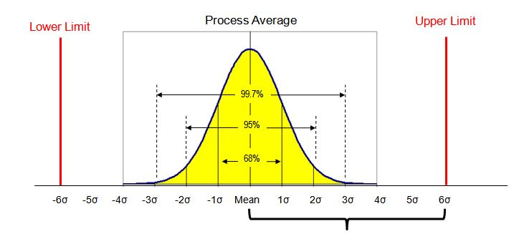
Capturing Baselines Using Process Sigma
Process Sigma focuses on ‘output performance’ and ‘defects’ produced by the process.
How the process performs most of the time.
Capturing a sigma baseline helps us measure how well a process is performing. It can be represented in graph format.
It helps us understand:
How consistently the process meets customer requirements.
How much variation exists in the process.
How many defects are being produced.
Where improvement opportunities exist.
Whether changes made to the process are improving performance.
Sigma measures how much variation exists around the process average.
Notes:
TIMING: 2 MINUTES
SPEAKER SCRIPT
A sigma baseline describes current process performance. It helps us understand typical performance, variation around the average, defect volume, and where improvement opportunities may exist. The chart is a visual reminder that a process can have the same average while showing very different amounts of variation. After a change, we can compare the new result with the baseline to determine whether performance truly improved rather than relying on one good week or one isolated result.

Slide 28
Examples of Sigma Impact
These defects represent examples of customer-impacting errors that Process Sigma can measure.
Employment Services
Job seeker assessment not completed.
Incorrect training or support program assigned.
Employer referral not submitted on time.
Housing
Services
Supporting evidence missing or incomplete.
Housing application assessed incorrectly.
Housing decision not communicated within target timescales.
Occupational
Health
Occupational health appointment scheduled incorrectly.
Medical information missing or recorded inaccurately.
Return-to-work recommendations not communicated to the manager.
Child Care
Services
Child placement information recorded incorrectly.
Required safeguarding documentation missing.
Care plan review not completed on time.
Shared
Services
Employee case routed to the wrong team.
Employee request not resolved within service level timescale.
Employee record updated incorrectly.
Each of these defects moves us further away from the perfect process.
Notes:
TIMING: 2 MINUTES
SPEAKER SCRIPT
These examples show customer-impacting defects across different services. In employment services, an incomplete assessment, incorrect training assignment, or late employer referral can delay progress for a job seeker. In shared services, wrong routing or an incorrect record can create rework for local teams. Tracking these defects establishes a baseline and helps direct improvement support. The intent is not to compare unlike services without context. It is to use a consistent method within each process and monitor whether quality improves.

Slide 29
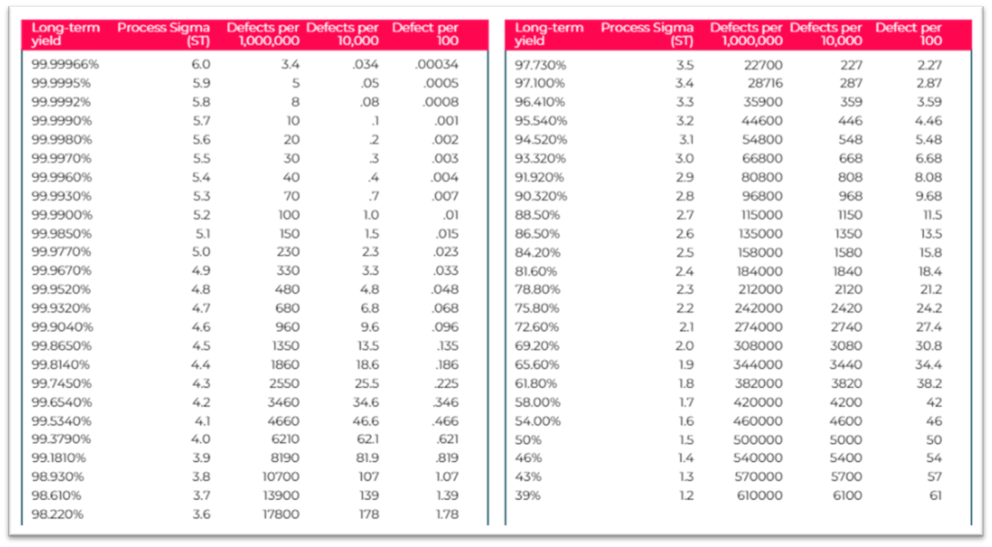
Process Sigma Table
The sigma table below is used to convert DPMO data into Sigma Value:
Example Sigma Value conversion:
Number of units: 100
Opportunities per unit: 5
Total number of defects: 7
DPU = 7/100 = 0.07
DPMO = 0.07/5 X 1,000,000 = 14000
Process Sigma ≈ 3.7 (from table)
*Always go to the nearest DPMO
Lower DPMO = Higher Sigma = Better quality
Notes:
TIMING: 2.5 MINUTES
SPEAKER SCRIPT
To convert DPMO to sigma, locate the nearest DPMO value in the table and read the corresponding sigma level. In the example, seven defects across 100 units gives a DPU of 0.07. Divide by five opportunities and multiply by one million to get 14,000 DPMO. The nearest value on the table corresponds to approximately 3.7 sigma. Remember the direction: lower DPMO means higher sigma and better quality.

Slide 30
Activity – calculate Sigma value
Using the table below and the data provided, calculate the value for the following processes:
Number of units: 800
Number of opportunities: 20
Total number of defects: 12
DPU:
DPMO:
Process Sigma:
Number of units: 150
Number of opportunities: 7.5
Total number of defects 10
DPU:
DPMO:
Process Sigma:
Number of units: 75
Number of opportunities: 9
Total number of defects 7
DPU:
DPMO:
Process Sigma:
Reminder: Always go to the nearest DPMO.
Notes:
TIMING: 3 MINUTES
SPEAKER SCRIPT
Work through the three examples independently or with a partner. For each one, calculate DPU first, then divide by the opportunities per unit and multiply by one million. Finally, use the sigma table and choose the nearest DPMO value. I will give you several minutes, then we will check each answer together. [Pause for activity and circulate through responses.]

Slide 31
Activity – solutions
Number of units: 800
Number of opportunities: 20
Total number of defects:12
DPU: 12/800 = 0.015
DPMO: 0.015/20 x 1,000,000 = 750
Process Sigma: 4.7
Number of units: 150
Number of opportunities: 7
Total number of defects: 10
DPU: 10/150 – 0.066
DPMO: 0.066/7 x 1,000,000 = 9,428
Process Sigma: 4.0
Number of units: 75
Number of opportunities: 9
Total number of defects: 7
DPU: 7/75 = 0.093
DPMO: 0.093/9 x 1,000,000 =
10,370
Process Sigma: 3.8
Notes:
TIMING: 2 MINUTES
SPEAKER SCRIPT
Let's review. For the first process, 12 divided by 800 gives 0.015 DPU. Dividing by 20 opportunities and multiplying by one million gives 750 DPMO, approximately 4.7 sigma. For the second, use seven opportunities as shown in the solution: 10 divided by 150 is about 0.0667; divided by seven and multiplied by one million is about 9,524 DPMO, close to the displayed rounded result and approximately 4.0 sigma. For the third, seven divided by 75 is about 0.0933; divided by nine and multiplied by one million is about 10,370 DPMO, approximately 3.8 sigma. Small differences can come from rounding, so retain enough decimal precision until the end.

Slide 32
3
Exploring Opportunities for Improvement
Summarizing Data
Notes:
TIMING: 0.5 MINUTES
SPEAKER SCRIPT
Now we will use these measures to explore improvement opportunities. The question shifts from 'What is the score?' to 'What does the score tell us to investigate?'

Slide 33
Activity - Opportunity for Improvement
The business has recently launched an employee information pack and has arranged for printing with its new supplier.
Our Communications Team sampled 100 updated information packs and found 5 defects.
These included:
Spelling errors
Incorrect color palette
Missing content
Image distortion
Missing staples
DPU: Defects per unit (DPU) was 0.05 (5/100)
DPMO: DPU/Opportunities x by 1,000,000 = 1,250
Opportunities
Each information pack has:
20 Pages
15 high resolution images
5 printing & finishing process steps
= 40 opportunities for defect
Using the table - what is the Sigma now?
Using the table - what is the Sigma?
Notes:
TIMING: 2 MINUTES
SPEAKER SCRIPT
This activity uses printed information packs. One hundred packs were sampled, five defects were found, and each pack has 40 defined opportunities. DPU is 0.05. Divide by 40 and multiply by one million to get 1,250 DPMO. Use the sigma table to find the corresponding level. Then compare that with the result you would get if you looked only at defective units and ignored opportunities. [Pause for calculation.]

Slide 34
Activity - Opportunity for Improvement
The business has recently launched an employee information pack and has arranged for printing with its new supplier.
Our Communications Team sampled 100 updated information packs and found 5 defects.
These included:
Spelling errors
Incorrect color palette
Missing content
Image distortion
Missing staples
DPU: Defects per unit (DPU) was 0.05 (5/100)
DPMO: DPU/Opportunities x by 1,000,000 = 1,250
Opportunities
Each information pack has:
20 pages
15 high resolution images
5 printing & finishing process steps
= 40 opportunities for defect
Sigma based on DPU and no opportunities = 3.0–3.1
Sigma based on DPMO = 4.5-4.6
Notes:
TIMING: 2 MINUTES
SPEAKER SCRIPT
The DPMO result of 1,250 corresponds to approximately 4.5 to 4.6 sigma on the table, while looking only at the unit-level defect result gives a much lower sigma estimate. The purpose of opportunities is to account for process complexity. A pack with many pages, images, and finishing steps has more defined chances for a defect than a simple one-page item. Use this carefully: opportunities must be defined consistently, not increased simply to make the score look better.

Slide 35
Let’s check the table
1
Based on just defects per 100. You can see there were 5 defects. Giving the process a:
95% yield
Sigma of 3.1 – 3.2
2
Including opportunities for defects per million (DPMO)
DPMO sits between 4.5 – 4.6
Notes:
TIMING: 2 MINUTES
SPEAKER SCRIPT
Let's confirm those values on the table. The unit-level view shows 95 percent yield and a sigma level around 3.1 to 3.2. The opportunity-adjusted DPMO of 1,250 falls around 4.5 to 4.6 sigma. These measures answer different questions. Yield tells us how many packs were defect-free. DPMO describes defects relative to the defined opportunities. We should report the definition alongside the result so the audience understands what is being compared.

Slide 36
Activity - opportunities for improvement
Our communications team have decided to redesign the existing pack and design a second version before releasing it to the teams.
Our Communications Team sampled 100 updated information packs and found 3 defects.
These included:
Spelling errors
Missing content
Incorrect numbering
DPU: Defects per unit (DPU) was 0.03 (3/100)
DPMO: DPU/Opportunities x 1,000,000 = 0.03/78 x 1,000,000 = 384.6 (385)
Opportunities
Each information pack has:
45 pages
25 high resolution images
8 printing and finishing process steps
78 = opportunities for defect
Process sigma based on DPU and no opportunities
= 3.3–3.4
Using the table, what is the new sigma score?
Notes:
TIMING: 3 MINUTES
SPEAKER SCRIPT
Now consider the redesigned pack. The sample contains 100 packs and three defects. Each pack has 78 defined opportunities. DPU is 0.03. Divide by 78 and multiply by one million to get approximately 385 DPMO. Use the sigma table to identify the corresponding sigma level. As you work, consider whether the redesign actually reduced customer-visible defects and whether the opportunity definition remained consistent. [Pause for calculation.]

Slide 37
Activity- Answer
Our Communications Team sampled 100 updated information packs and found 3 defects.
These included:
Spelling errors
Missing content
Incorrect numbering
DPU: Defects per unit (DPU) was 0.03 (3/100)
DPMO: DPU/Opportunities x 1,000,000 = 0.03/78 x 1,000,000 = 384.6 (385)
Opportunities
Each information pack has:
45 Pages
25 high resolution images
8 printing and finishing process steps
78 = opportunities for defect
Sigma based on DPU and no opportunities = 3.3–3.4
Sigma with opportunities 4.8 - 4.9
Notes:
TIMING: 2 MINUTES
SPEAKER SCRIPT
The opportunity-adjusted result is approximately 4.8 to 4.9 sigma, while the unit-level view is around 3.3 to 3.4. The DPMO calculation is 0.03 divided by 78, multiplied by one million, which is approximately 385. The main lesson is to calculate from the same definitions each time and keep full precision until the final step.

Slide 38
Let’s check the table
1
Based on defects per 100. You can see there were 5 defects.
Giving the process a:
97% yield
Sigma of 3.3–3.4
2
Including opportunities for defects per million (DPMO).
DPMO of 1250 sits between 4.8-4.9
Notes:
TIMING: 2 MINUTES
SPEAKER SCRIPT
Use the table to confirm the result. With three defective packs out of 100, the yield is 97 percent and the unit-level sigma is about 3.3 to 3.4. With 385 DPMO, the opportunity-adjusted sigma is about 4.8 to 4.9. Mark both locations so the distinction is visible.

Slide 39
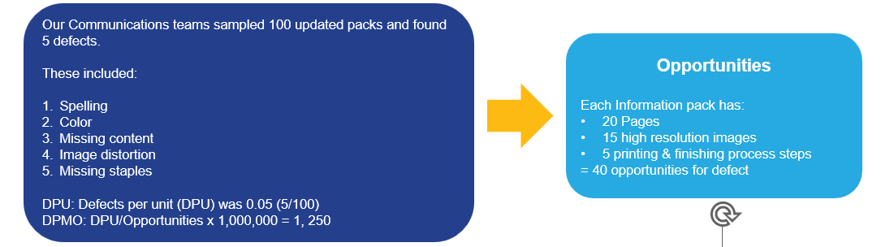
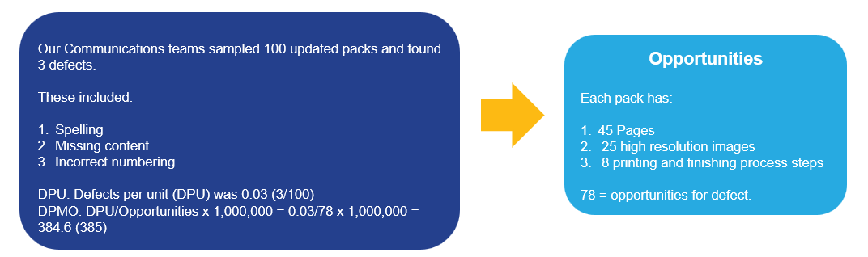
Which Information Pack format is better?
Info pack Version 1
Info Pack Version 2
Our Marcoms teams sampled 100 packs and found :
1250 = 4.5 - 4.6 Sigma
385 = 4.8 - 4.9 Sigma
The higher the sigma level the better the quality of the product or service and the fewer the defects. ​
Notes:
TIMING: 2 MINUTES
SPEAKER SCRIPT
Which format is better? Version 2 has fewer observed defects and a higher opportunity-adjusted sigma result. That suggests better quality in this example. But we should also ask whether the additional pages, images, and finishing steps add customer value. A more complex product can achieve a strong quality score and still cost more to produce or maintain. For Equus, the better option should balance customer usefulness, defect performance, effort, and return on investment.

Slide 40
Activity: Process Sigma
Based on the DPMO we previously created, what is the Sigma for this process?
Identify Opportunities per item
Calculate the total opportunities (what could go wrong)
4 potential defects x 200 new starters = 800 opportunities
Calculate DPU (what did go wrong)
16 defects/200 families = 0.08 defects per item
Apply DPMO
DPMO = (DPU ÷ Opportunities) × 1,000,000
= (0.08÷ 7 Defects) × 1,000,000
= 20,000 Child Care defects per million opportunities
Notes:
TIMING: 2.5 MINUTES
SPEAKER SCRIPT
Return to the Child Care example. We calculated 20,000 DPMO. Use the table to find the sigma level. [Pause.] The displayed interpretation is approximately 2.3 to 2.4 sigma. The important follow-up is not just the score. Review which defect categories contribute most and which changes would protect families from delay, incorrect eligibility decisions, or missing notices.

Slide 41
4
Rolled Throughput Yield
Summarizing Data
Notes:
TIMING: 0.5 MINUTES
SPEAKER SCRIPT
The final section introduces Rolled Throughput Yield. This measure helps us see quality across every step rather than only at the final output.

Slide 42
What is Rolled Throughput Yield (RTY)?
Each step has a probability of defects, and these yields represent first-time pass performance.
Step 1
95% Yield
Step 2
95% Yield
Step 3
85% Yield
Output
76.7%
Rolled Throughput Yield
Measures probability of passing each step defect-free.
Shows the true performance of the whole process.
It shows:
The cumulative impact of defects across all steps.
Where quality is lost within the process.
RTY (All steps) = 0.95 x 0.95 x 0.85 x100 = 77%
Final Yield
Shows the final output only.
Shows what reaches the customer.
Final = 77/100
What this shows:
77% of units passed through all steps without any defects (RTY).
77% were delivered to the customer (Final Yield).
It means the process is performing cleanly, with no hidden rework or inefficiency.
Key Takeaway: Final Yield can be misleading because it hides rework and inefficiencies.
Notes:
TIMING: 2.5 MINUTES
SPEAKER SCRIPT
Final Yield shows what reaches the customer. Rolled Throughput Yield, or RTY, shows the probability that a unit passes every step without a defect. To calculate RTY, multiply the first-time yield for each step. Using the values shown on the slide, 0.95 times 0.95 times 0.85 is approximately 0.767, or 76.7 percent. When RTY and Final Yield are similar, there is little hidden rework. When Final Yield is much higher than RTY, the final result may look good only because people are correcting errors behind the scenes.

Slide 43
Example: RTY - IT Service Desk Requests
An IT service desk is handling requests through three steps, but issues along the way mean many requests require rework before being completed.
Step 1
90% Yield
Step 2
80% Yield
Step 3
95% Yield
Output
95%
Rolled Throughput Yield
Measures probability of passing each step defect-free.
Shows the true performance of the whole process.
It shows:
The cumulative impact of defects across all steps.
Where quality is lost within the process.
RTY (All steps) 0.90 × 0.80 × 0.95 = 0.684 x 100 = 68.4%
Final Yield
Shows the final output only.
Shows what reaches the customer.
Final = 95/100
What this shows:
Although 95% of requests or outcomes reach the customer correctly completed, only 68.4% made it through the process without any problems.
Means: Lots of fixing, reprocessing, or rework happening. This shows the process is inefficient.
Step 2 is the weak point.
Key Takeaway: Final Yield can be misleading because it hides rework and inefficiencies.
Notes:
TIMING: 2.5 MINUTES
SPEAKER SCRIPT
The IT service example makes that difference clear. The three first-time yields are 90 percent, 80 percent, and 95 percent. Multiply them to get 68.4 percent RTY. Yet Final Yield is 95 percent. Customers eventually receive a completed request, but only about 68 percent moved through the full process without an issue. Step 2 is the weakest point. In an Equus enabling function, this kind of analysis can reveal where local teams experience delays or repeated handoffs even when the final service-level result looks acceptable.

Slide 44
The Hidden Factory: The Cost of Poor Quality
Using the previous example, let’s now look at the extra effort that goes into the process.
31.6% of work (31.6 out of 100 requests) is waste or rework. That means more than third of the effort creates no value for the customer.
10 missing information
5 requests failed/cancelled/escalated.
26.6 requests require time and resource
(Hidden effort).
18 wrong routing
3.6 incorrect resolution - reopened
‘THE HIDDEN FACTORY’
Work the customer does not see - fixing, redoing, and correcting errors.
Notes:
TIMING: 2 MINUTES
SPEAKER SCRIPT
The gap between Final Yield and RTY represents hidden work: fixing, redoing, routing again, reopening, and correcting errors that do not add customer value. This is often called the Hidden Factory or the cost of poor quality. In the example, 31.6 requests out of 100 involve failure or rework. That hidden effort consumes capacity that could otherwise support customers, employers, or project teams. Reducing it improves both customer experience and return on investment.

Slide 45
Overview of Rolled Throughput Yield
31.6 reworked IT Requests
Process - Step 1
(missing info)
90/100 = 0.90
90% Yield
Process Step 2
(Routing) 72/90=0.80
80% yield
Step 3
(Resolution)
68.4/72 =0.95
95% yield
RTY =
0.90 × 0.80 × 0.95
=0.684
=68.4%
100 IT requests scheduled
10 missing information
18 wrong routing
3.6 incorrect resolution. Reopened.
Notes:
TIMING: 2 MINUTES
SPEAKER SCRIPT
This summary shows where the hidden work is created. Step 1 loses 10 requests to missing information. Step 2 has the lowest yield and creates the largest loss through routing. Step 3 loses additional work through incorrect resolution and reopening. Step 2 should be prioritized because it has the lowest yield and the largest contribution to rework. The improvement team should still investigate root causes before selecting a solution, but the RTY breakdown tells us where to begin.

Slide 46
Summary
What Have We Learned?
In this module we have learned:
Defects are outputs that do not meet customer requirements.
Yield measures how often we get things right first time.
DPU measures how many defects exist within each unit.
Opportunities are points where defects could occur.
DPMO standardizes defect rates so processes can be compared.
Process Sigma converts DPMO into a measure of process capability.
RTY shows the true performance of a process across multiple steps.
Hidden Factory reveals the cost of rework, delays and corrections.
Key Takeaway: Better processes create fewer defects, less rework and better outcomes for customers.
Notes:
TIMING: 2 MINUTES
SPEAKER SCRIPT
Let's summarize. Defects are outputs that do not meet customer requirements. Final Yield tells us how often work is right first time. DPU counts defects within units. Opportunities are defined points where defects could occur. DPMO standardizes performance, and Process Sigma translates that result into a capability measure. RTY shows performance across all steps, while the Hidden Factory exposes rework and correction effort. Together, these measures help us focus improvement on fewer defects, less waste, better customer outcomes, and stronger use of resources.

Slide 47
Thank you
Thank you for your participation. You have now completed the learning for this module.
Once your attendance has been captured, your module end test will be available. Slides for this session will also be available for review.
Notes:
TIMING: 1 MINUTES
SPEAKER SCRIPT
Thank you for your participation. Before we close, choose one process you work with and identify the measure from today's session that would add the most useful insight. Would you begin with Final Yield, DPU, DPMO, sigma, or RTY? Add your answer in the chat, along with one sentence explaining why. Once attendance is recorded, the module-end test and slides will be available according to the course process.

